Slide 1
GAS LAWS

Slide 2
Specification
describe the Kelvin scale of temperature and be able to convert between the Kelvin and Celsius scales
understand that an increase in temperature results in an increase in the speed of gas molecules
understand that the Kelvin temperature of the gas is proportional to the average kinetic energy of its molecules
describe the qualitative relationship between pressure and Kelvin temperature for a gas in a sealed container
use the relationship between the pressure and Kelvin temperature of a fixed mass of gas at constant volume:
p₁ / T₁ = p₂ / T₂
use the relationship between the pressure and volume of a fixed mass of gas at constant temperature:
p₁V₁ = p₂V₂

Slide 3
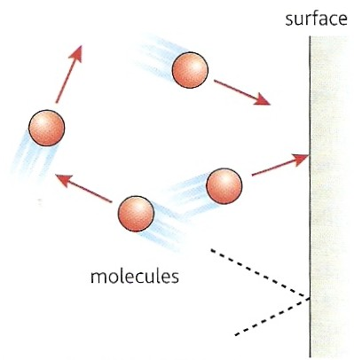
Gas pressure
The particle theory of a gas explains gas pressure in the following way:
Gas molecules in constant random motion.
When a molecule collides with a surface it exerts a force on the surface as it changes its direction.
The pressure exerted by the gas is equal to the total force in exerted by the molecules over an area of the surface divided by the area.
Notes:
3

Slide 4
Boyle’s law
Boyle’s law states that the pressure of a gas is inversely proportional to its volume.
This means that if the volume of a gas is doubled its pressure will halve.
Boyle’s law only applies for a gas if its mass and temperature is kept constant while the volume is being changed.
Notes:
4
4

Slide 5
Mathematically Boyle’s law can be stated:
p₁ x V₁ = p₂ x V₂
where:
p₁ = initial gas pressure
p₂ = final gas pressure
V₁ = initial gas volume
V₂ = final gas volume
Notes:
5
5

Slide 6
Boyle’s law question
A gas has an initial volume of 30 m³ at atmospheric pressure (100 kPa).
Calculate the final pressure of this gas if its volume is decreased to 10 m³.
Notes:
6

Slide 7
Boyle’s law question
A gas has an initial volume of 30 m³ at atmospheric pressure (100 kPa).
Calculate the final pressure of this gas if its volume is decreased to 10 m³.
Boyle’s law: p₁ x V₁ = p₂ x V₂
100 kPa x 30 m³ = p₂ x 10 m³
3 000k = 10 p₂
p₂ = 3 000k / 10
Final pressure = 300 kPa
Notes:
7

Slide 8
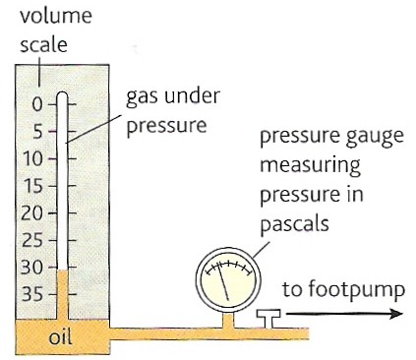
Checking Boyle’s law experimentally
Record the initial volume and pressure of the gas in the tube.
Use the foot pump to decrease the volume of the gas in the tube.
Record the new volume and pressure.
Use the foot pump to obtain further sets of volume and pressure measurements.
Notes:
8

Slide 9
Plot a graph of pressure, p
(y-axis) against one divided by volume, 1 / V (x-axis).
If this graph is a straight line through the origin then Boyle’s law is confirmed.
Boyle’s law is also confirmed if each set of volume and pressure measurements give the same answer when they are multiplied together.
That is: p x V = a constant
pressure
1
volume
Notes:
9
9

Slide 10
Pressure against volume graph
If a pressure is plotted against volume graph is plotted then a curved line is produced.
This line does not intercept either of the axes.
250
200
pressure (kPa)
150
100
50
10
20
30
40
50
volume (cm³)
Notes:
10
10

Slide 11
Complete:
p₁ / Pa | V₁ / cm³ | p₂ / Pa | V₂ / cm³
100 k | 30 | 600 k | 5
100 k | 30 | 25 | 15
100 k | 25 | 20 k | 75
100 k | 20 |  | 80
50 k |  | 150 k | 20
 | 10 | 100 k | 50
Notes:
11
11

Slide 12
Complete:
p₁ / Pa | V₁ / cm³ | p₂ / Pa | V₂ / cm³
100 k | 30 | 600 k | 5
100 k | 30 | 25 | 15
100 k | 25 | 20 k | 75
100 k | 20 |  | 80
50 k |  | 150 k | 20
 | 10 | 100 k | 50
5
200 k
125
25 k
60
500 k
Notes:
12
12

Slide 13
Choose appropriate words to fill in the gaps below:
A gas consists of particles called __________ that are in continual _________ motion.
The pressure of a gas is caused by the _______ exerted by the molecules when they ________ and rebound off the surface experiencing the pressure.
According to ________ law the pressure of a gas __________ by its volume is equal to a _________ number provided the _____________ of the gas does not change.
WORD SELECTION:
multiplied
temperature
constant
Boyle’s
collide
random
force
molecules
Notes:
13
13
13

Slide 14
Choose appropriate words to fill in the gaps below:
A gas consists of particles called __________ that are in continual _________ motion.
The pressure of a gas is caused by the _______ exerted by the molecules when they ________ and rebound off the surface experiencing the pressure.
According to ________ law the pressure of a gas __________ by its volume is equal to a _________ number provided the _____________ of the gas does not change.
molecules
random
force
collide
Boyle’s
multiplied
constant
temperature
WORD SELECTION:
multiplied
temperature
constant
Boyle’s
collide
random
force
molecules
Notes:
14
14
14

Slide 15
Absolute zero
As temperature decreases the average speed at which molecules move decreases.
Eventually at a temperature called absolute zero all molecules will cease moving.
Absolute zero = - 273°C
(more exactly = - 273.15°C)
It is not possible to achieve this temperature.
The current (2012) record lowest temperature is:
– 273.149 999 999 900 °C
Notes:
15

Slide 16
The kelvin temperature scale
This kelvin scale starts from absolute zero:
0 kelvin (0 K) = - 273 °C
A change of one kelvin is the same as
a change of one °C
Therefore: 0 °C (melting ice) = + 273 K
100 °C (boiling water) = + 373 K
kelvin temperature = °C temperature + 273
Note: It is incorrect to write or say “degrees kelvin”
Notes:
16

Slide 17
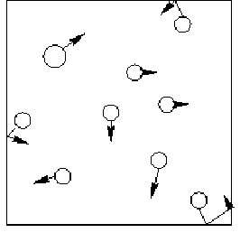
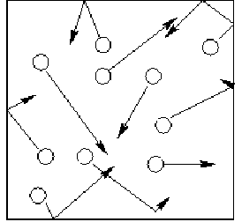
Gas pressure and temperature
As temperature increases:
molecules move quickly
therefore exerting a greater force
and so producing a greater pressure
Cold gas
Hot gas
Notes:
17
17

Slide 18
Molecular kinetic energy
As temperature increases the average speed and kinetic energy of the molecules increases.
With an ideal gas:
The average kinetic energy of the molecules is proportional to the kelvin temperature.
Notes:
18

Slide 19
Question 1
The temperature of a gas is increased from
- 123°C to 377 °C. What change occurs to the average kinetic energy of the gas molecules?
initial gas temperature
= -123°C
= 150 K
final gas temperature
= 327°C
= 600 K
the kelvin temperature increases by 4 times
therefore average kinetic energy increases by 4 times
Notes:
19

Slide 20
Question 2
When the temperature of a gas is increased from 27°C the average speed of the molecules increases three fold. Calculate the final temperature of the gas.
kinetic energy = ½ mv²
If the speed, v increases by 3 times, the kinetic energy increases by 3², 9 times.
and so the kelvin temperature increases by 9 times.
initial temperature = 27°C
= 300 K
therefore final temperature = 9 x 300 K
= 2700 K
(or 2427 °C)
Notes:
20

Slide 21
The Pressure Law
The pressure law states that the pressure of a fixed mass of gas at a constant volume is proportional to its kelvin temperature.
This means that if the kelvin temperature of a gas is doubled its pressure will also double.
Notes:
21

Slide 22
Mathematically the pressure law can be stated:
p₁ = p₂
T₁ T₂
Where:
p₁ = the initial pressure
p₂ = the final pressure
T₁ = the initial kelvin temperature
T₂ = the final kelvin temperature
Notes:
22
22

Slide 23
Pressure law question
A gas has an initial pressure of 40kPa at a temperature of - 73ºC. Calculate the final pressure of this gas if its temperature is increased to 327ºC at a constant volume.
Notes:
23

Slide 24
Pressure law question
A gas has an initial pressure of 40kPa at a temperature of - 73ºC. Calculate the final pressure of this gas if its temperature is increased to 327ºC at a constant volume.
Pressure law: p₁ / T₁ = p₂ / T₂
Temperatures must be in kelvin!
so: T₁ = 200K and T₂ = 600K
40 kPa / 200K = p₂ / 600K
p₂ = (40 000 x 600) / 200
Final pressure = 120 kPa
Notes:
24

Slide 25
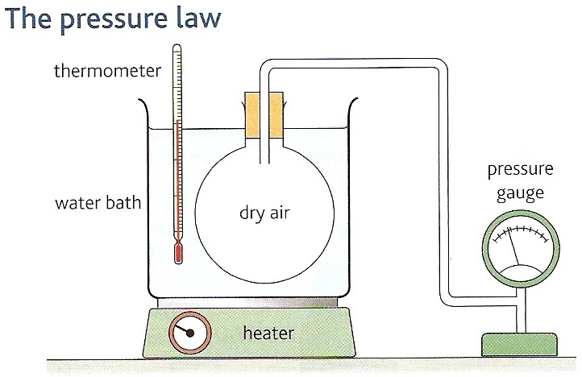
Checking the pressure law experimentally
Record the initial pressure of the air in the round bottomed flask and the temperature of the water bath which is equal to the temperature of the air.
Use the heater to increase the temperature.
Record the new temperature and pressure.
Obtain further sets of temperature and pressure measurements.
Convert all temperature measurements to kelvin.
Notes:
25
25

Slide 26
Plot a graph of pressure, p
(y-axis) against temperature in kelvin, T (x-axis).
If this graph is a straight line through the origin then the pressure law is confirmed.
The pressure law is also confirmed if each set of kelvin temperature and pressure measurements give the same answer when the pressure is divided by the kelvin temperature.
That is: p ÷ V = a constant
pressure
kelvin temperature
Notes:
26
26

Slide 27
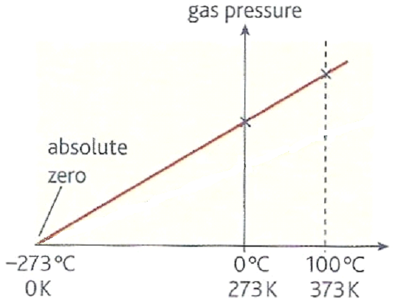
Pressure against °C temperature graph
The straight line crosses the temperature axis at absolute zero
(-273°C)
Notes:
27
27

Slide 28
Complete:
p₁ | T₁ | p₂ | T₂
100 kPa | 300 K |  | 150 K
60 kPa | 200 K | 240 kPa
 | 800 K | 120 kPa | 600 K
50 kPa |  | 300 kPa | 360 K
50 kPa | 27ºC |  | 627ºC
150 kPa | 450 K | 100 kPa
Notes:
28

Slide 29
Complete:
p₁ | T₁ | p₂ | T₂
100 kPa | 300 K |  | 150 K
60 kPa | 200 K | 240 kPa
 | 800 K | 120 kPa | 600 K
50 kPa |  | 300 kPa | 360 K
50 kPa | 27ºC |  | 627ºC
150 kPa | 450 K | 100 kPa
50 kPa
800 K
160 kPa
60 K
150 kPa
27°C
Notes:
29

Slide 30
Choose appropriate words to fill in the gaps below:
When the _______ temperature of a gas is doubled the average _______ energy of its molecules is also doubled.
The ________ law states that the pressure of a gas is ___________ to its kelvin temperature provided its ______ and volume remain constant.
According to the pressure law, the pressure of a gas should fall to _______ at a temperature of _________, also known as absolute zero.
WORD SELECTION:
proportional
- 273°C
pressure
kelvin
kinetic
zero
mass
Notes:
30
30

Slide 31
Choose appropriate words to fill in the gaps below:
When the _______ temperature of a gas is doubled the average _______ energy of its molecules is also doubled.
The ________ law states that the pressure of a gas is ___________ to its kelvin temperature provided its ______ and volume remain constant.
According to the pressure law, the pressure of a gas should fall to _______ at a temperature of _________, also known as absolute zero.
kelvin
kinetic
pressure
proportional
mass
zero
- 273°C
WORD SELECTION:
proportional
- 273°C
pressure
kelvin
kinetic
zero
mass
Notes:
31
31

